Slide 1
ONE-INNOVATION HUB AI CLASS
NAÏVE BAYES ALGORITHM

Slide 2
INTRODUCTION
It is a classification technique based on Bayes’ Theorem with an assumption of independence among predictors.
In simple terms, a Naive Bayes classifier assumes that the presence of a particular feature in a class is unrelated to the presence of any other feature.

Slide 3
WHAT IS BAYES THEOREM?
It is a simple mathematical formula used for calculating conditional probabilities.
Conditional probability is a measure of the probability of an event occurring given that another event has (by assumption, presumption, assertion, or evidence) occurred.

Slide 4
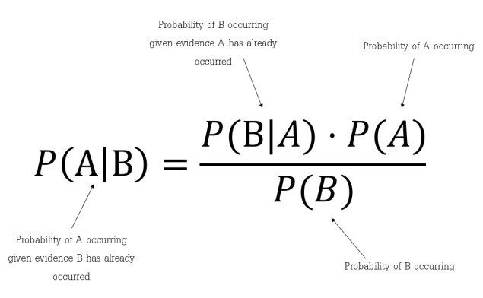
Which tells us: how often A happens given that B happens, written P(A|B) also called posterior probability, When we know: how often B happens given that A happens, written P(B|A) and how likely A is on its own, written P(A) and how likely B is on its own, written P(B)

Slide 5
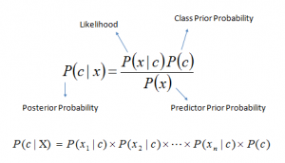
P(c|x) is the posterior probability of class (c, target) given predictor (x, attributes).
P(c) is the prior probability of class.
P(x|c) is the likelihood which is the probability of predictor given class.
P(x) is the prior probability of predictor.

Slide 6
WHAT THE NAÏVE BAYES ASSUMPTIONS ARE
The fundamental Naïve Bayes assumption is that each feature makes an:
independent
equal
contribution to the outcome.
In other words, every pair of features being classified is independent of each other.

Slide 7
TYPES OF NAÏVE BAYES CLASSIFIER
Multinomial Naïve Bayes: It is used for discrete counts
Guassian Naïve Bayes: It assumes that features follow a normal distribution
Bernoulli: This binomial model is useful if feature vectors are binary (i.e. zeros and ones).
One application would be text classification with ‘bag of words’ model where the 1s & 0s are “word occurs in the document” and “word does not occur in the document” respectively.

Slide 8
TERMINOLOGIES IN NAÏVE BAYES
Likelihood: This is the probability that a thing would occur independently given it it exist in a given class. It is also sometimes referred to as probabilities.
Prior Probability: This is the initial guess that a particular event occurs/is observed in a given class.

Slide 9
An advantage of naive Bayes is that it only requires a small number of training data to estimate the parameters necessary for classification.
Popular uses of naive Bayes classifiers include spam filters, text analysis and medical diagnosis. These classifiers are widely used for machine learning because they are simple to implement.

Slide 10
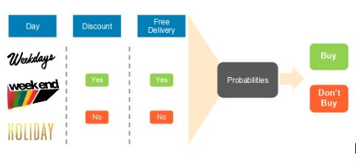
PRACTICAL APPROACH TO NAÏVE BAYES
For instance, to predict whether a person will purchase a product on a specific combination of day, discount and free delivery using a Naïve Bayes Classifier.

Slide 11
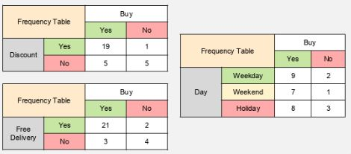

Slide 12
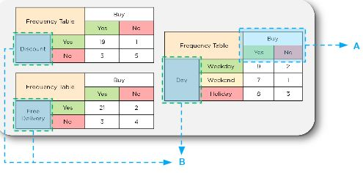
For Bayes Theorem, let the event “buy” be A and the independent variables (discount, free delivery and day) be B

Slide 13
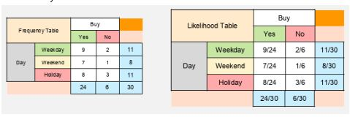
We will calculate the likelihood for one of the “day” variables which includes weekday, weekend and holiday variables.

Slide 14
Based on the likelihood table, let us calculate some conditional probabilities;
P(B) = P(Weekday) = 11/30 = 0.37
P(A) = P(No Buy) = 6/30 = 0.2
P(B|A) = P(Weekday |No Buy) = 2/6 = 0.33
P(A|B) = P(No Buy |Weekday) = (0.33 * 0.2) /0.37 = 0.18

Slide 15
The likelihood tables can be used to calculate whether a customer will purchase a product on a specific combination of the day when there is a discount and whether there is free delivery. Consider a combination of the following factors where B equals:
Day = Holiday
Discount = Yes
Free Delivery = Yes
Let us find the probability of them not purchasing based on the conditions above.

Slide 16
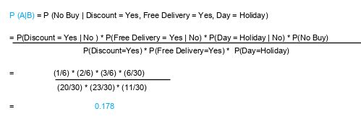
A = No Purchase

Slide 17
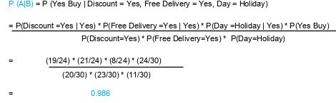
A = Buy

Slide 18
Finally, we have a conditional probability of purchase on this day.
Next, normalize these probabilities to get the likelihood of the events:
Sum of probabilities = 0.986 + 0.178 = 1.164
Likelihood of purchase = 0.986 / 1.164 = 84.71%
Likelihood of no purchase = 0.178 / 1.164 = 15.29%
Result: As 84.71% > 15.29%, we can conclude that an average customer will buy on holiday with a discount and free delivery

Slide 19
Pro of Naïve Bayes Classifier
It is simple and easy to implement
It doesn’t require as much training data
It handles both continuous and discrete data
It is highly scalable with the number of predictors and data points
It is fast and can be used to make real-time predictions
It is not sensitive to irrelevant features

Slide 20
Use Case of Naïve bayes
Text Classification
Spam detection
Sentiment Analysis
Recommendation System
Weather Forecasting

Slide 21
REFERENCES
Understanding Naïve Bayes Classifier https://www.simplilearn.com/tutorials/machine-learning-tutorial/naive-bayes-classifier

